Slide 1



CyberCatalyst.io/TechVets
Canadian Veterans Entering Software & Cyber Security Careers
Accelerate career preparation and placement of exmilitary and family members through management of ¹micro-credentialing, ²internships, ³job placement services and ⁴consulting assignments.
*Catalysts are widely used to speed up reactions, increase efficiency, and reduce costs.
TALENT SOLUTIONS

Slide 2

CyberCatalyst.io
Canadian Veterans Entering Software or Cyber Security Careers
TALENT SOLUTIONS

Slide 3
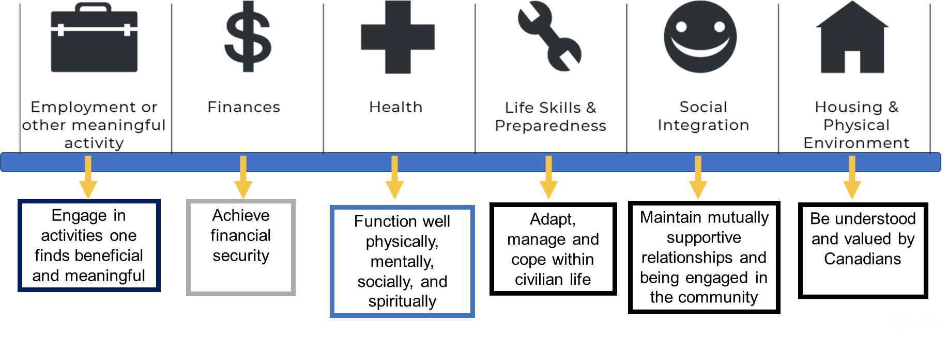
Components of a successful Transition Plan
When considering your transition, ask yourself where you stand in these domains of Well-Being…
Slide 3
Slide 3
Notes:
We have lined up with several of the transition unit domains of wellbeing and think that this program sets you on a great track for a successful transition and meaningful and rewarding career

Slide 4
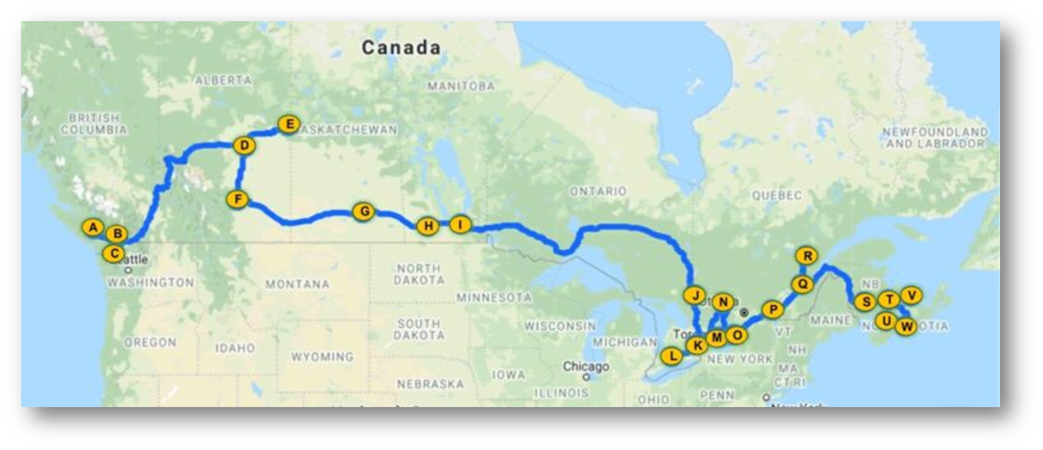
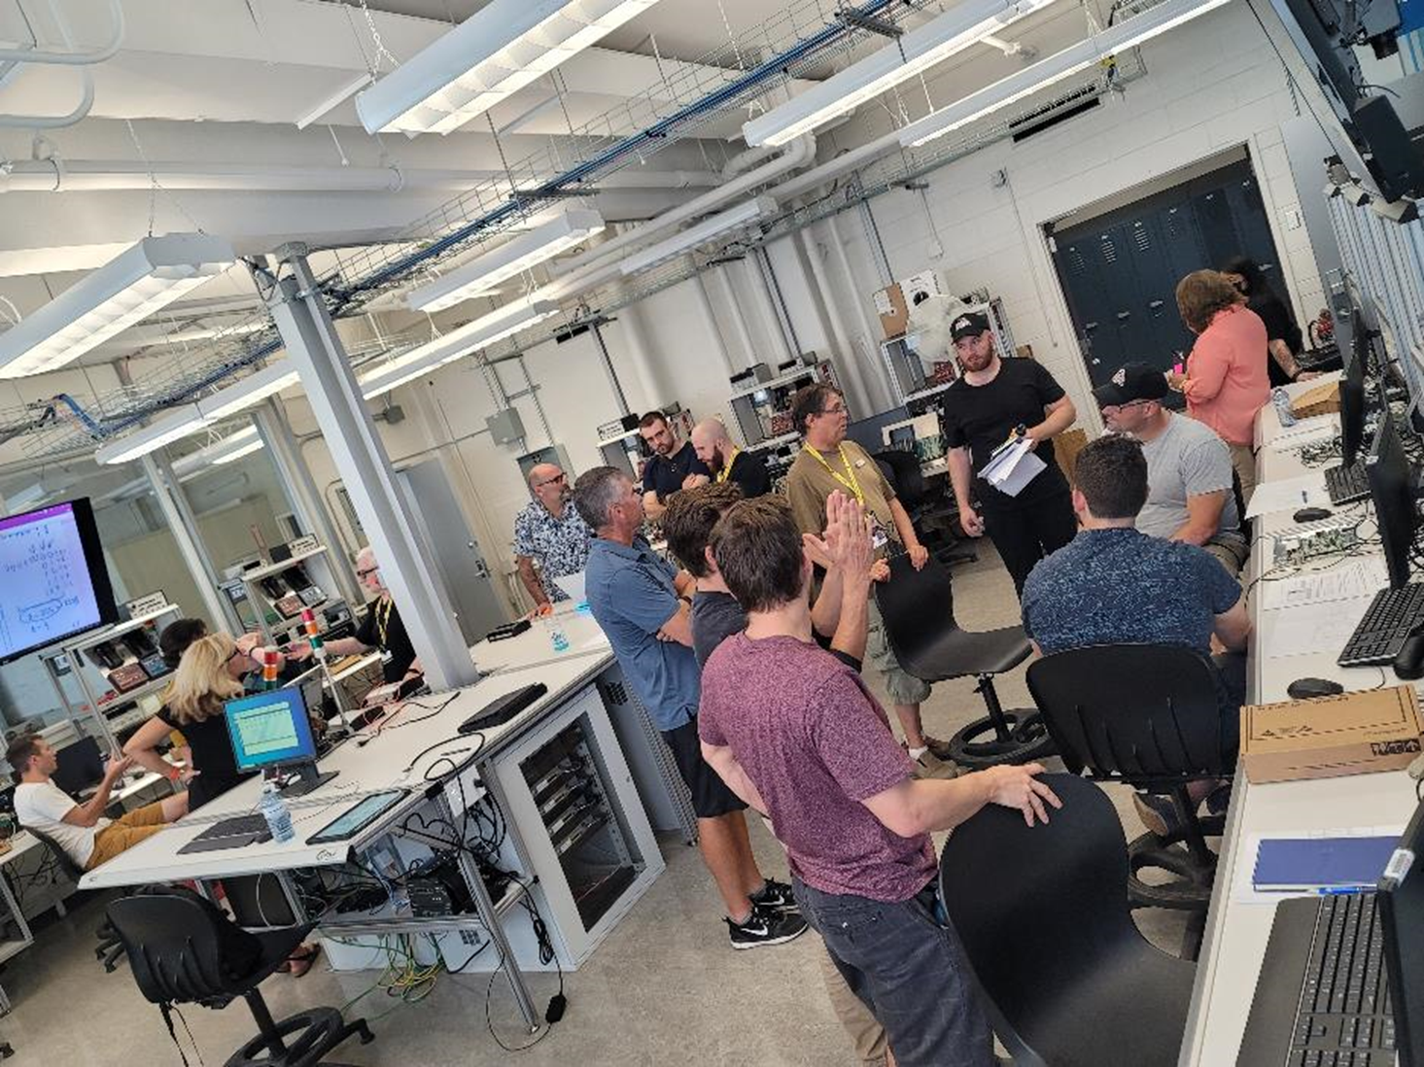

75 SCAN and Job Fairs
Cofounder, developed and launched CFV-uOttawa software and cyber programs
Established BCIT on-site industrial networking bootcamp
Stood up Cyber Catalyst to fulfill jobs objective
Military Service ^{to} Cyber Defence

Slide 5
Closing the Say:Do Gap
Mission
To secure career placement for Veterans in meeting Canada’s cyber defence mission.
Vision
That Veterans are personally recognized with meaningful and rewarding career opportunities advancing Canada’s cyber defence posture.
Purpose
To advocate for and provide career development support to cyber-prepared veterans through the management of specialized micro-credentialing, internships, individualized recruitment services and consulting assignments.
Military Service ^{to} Cyber Defence

Slide 6
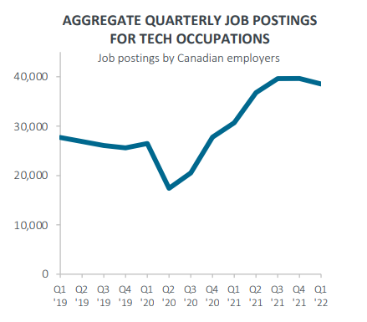
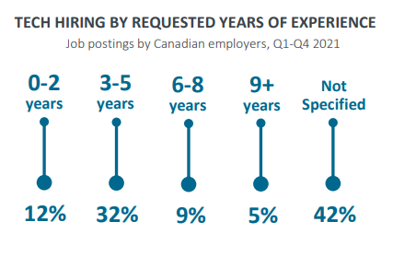
> 120,000 Job Postings per year

Slide 7
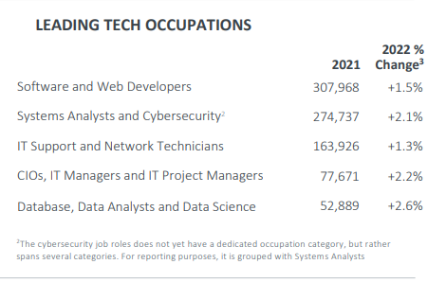

Slide 8
Is This For You?
Take a look
Did you know what you were getting into when you joined CAF?
This really is the first day of the rest of your working life at least. Get insights to what a day in that life looks like.
Take charge
Many ways to determine if this would be a fit for you.
Talk to many, and make the choice yours alone.
Take action
It isn’t too good to be true. It will take hard work.
Military Service ^{to} Cyber Defence
Notes:
Many of the most successful transitions to tech careers are by individuals who describe the experience as one where they took control of the release and transition process.

Slide 9


Slide 10
Why We Hire Veterans
1. UNPARALLELED TEAMWORK
2. STRONG SENSE OF DUTY
3. REALISTIC SELF-CONFIDENCE
4. STRONG ORGANIZATIONAL CULTURE
5. OPENNESS TO DIVERSITY.
6. WILLINGNESS TO TAKE ON AND FINISH DIFFICULT TASKS
7. CROSS-FUNCTIONALITY
8. QUICK & CREATIVE PROBLEM RESOLUTION.
9. ADAPTABILITY
10. RESPECT FOR RULES AND ORDER
Military Service ^{to} Cyber Defence
Notes:
1. UNPARALLELED TEAMWORK
Veterans have top-notch teamwork ethics. All Veterans have become part of a group, big and small, during their service. It is also the military principle that for a unit to function properly, all members must work in coordination with the crew.
2. STRONG SENSE OF DUTY
Completing missions are something that Veterans take the most pride in. There's always a goal to achieve and an order to execute for service members. When they take part in a civilian workgroup, you can most definitely expect them to be naturally driven to perform their duties and responsibilities.
3. REALISTIC SELF-CONFIDENCE
The military humbles all service members upon entry and even after separation. They say that entering service will take off one's filter of the world. Veterans have been exposed to life's harsh realities that their experiences sharpened them towards developing a more pragmatic sense of themselves and their abilities.
4. STRONG ORGANIZATIONAL CULTURE
Again, to be a service member means to automatically be part of the group. Employing a Veteran and assigning him or her to work in an organized group setting, should bring little to no problem.
5. OPENNESS TO DIVERSITY
Still touching on the topic of functioning as part of a whole, Veterans' military background most definitely opened them to diversity. A military unit may consist of men, women, LGBT members, and mixed races. A unit will not work as one if the members are hostile against anyone that's not part of a general group standard. A unit should be able to perform its duties regardless of the diversity in the group.
6. WILLINGNESS TO TAKE ON AND FINISH DIFFICULT TASKS
Having been goal-oriented, Veterans understand that an organization's success relies on taking on and finishing the tasks at hand no matter how difficult they are. Besides, a Veteran practically knows that no task is difficult when driven by teamwork.
7. CROSS-FUNCTIONALITY
Very rarely will you encounter a Veteran that doesn't possess cross-functional skills. Military service includes extensive trainings on several computer programs and systems of education to empower its members the ability to solve problems in different fields.
8. QUICK & CREATIVE PROBLEM RESOLUTION
Speaking of problem solving, Veterans also have a strong sense of tackling a problematic situation quickly and creatively - with as little casualty as possible. This is definitely a profitable skill to acquire in a workplace because efficient problem solving means minimal losses.
9. ADAPTABILITY
Change is constant in the military. Hence, it is important for each member to have the ability to adapt to any changes in situations, environments, leaders, and/or even group members. Just like in the military, civilian work life is prone to changes. Employing someone who is already used to adapting to changes will, for sure, be an asset to any company!
10. RESPECT FOR RULES AND OBEDIENCE
Rules lead to success while obedience is the key to success. Rules are not a foreign concept among Veterans. Military service allows Veterans to understand the importance of rules in a company. Veterans respect and obey rules because their experiences have inculcated in them a sense of trust in the legitimacy of command.
Hiring a Veteran gears your workplace towards success - is the short answer to the title question. Hiring a Veteran means hiring a dedicated employee that exudes teamwork, sense of accomplishment, and organizational prosperity.

Slide 11

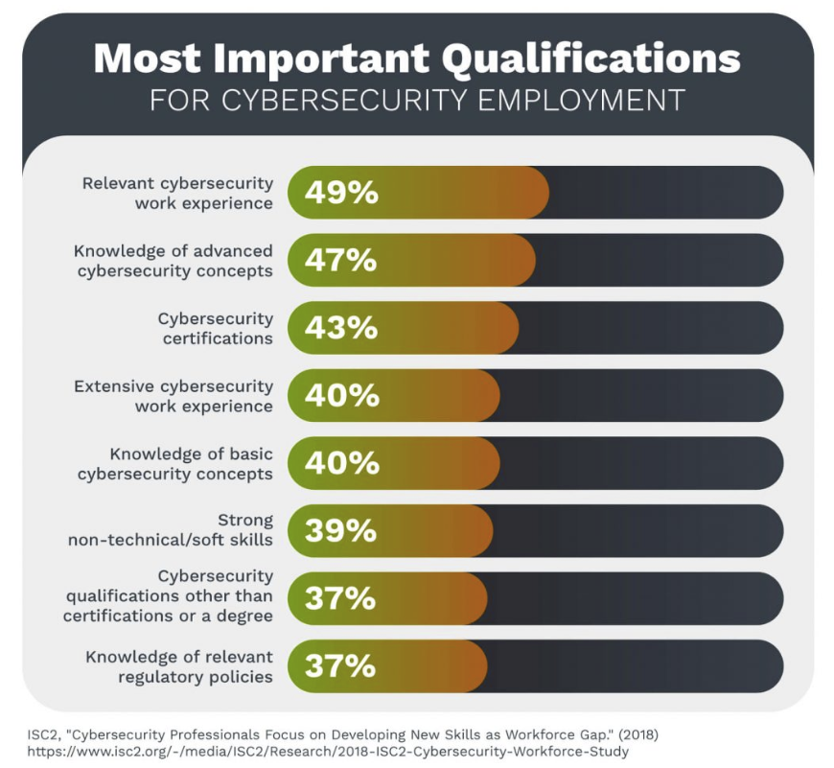
Candidate Skills Guarantee
Micro-credentialing
Practical skills development and recognition
Internships / Apprenticeships
Practice skills and gain experience ‘in theater’
Job placement
Workplace resilience – Coach | Mentor | Sponsor
Squad contracting
Team services model
https://techbootcamps.utexas.edu/blog/cybersecurity-analyst-job-description-role-breakdown/
Military Service ^{to} Cyber Defence

Slide 12
AWS security engineer
Cyber security analyst
Cyber security specialist
DevSecOps specialist
GCP security engineer
Information security engineer
.NET Developer
Android Developer
Application security administrator
Application Security Engineer
Application security specialist
Artificial Intelligence (AI) / Machine Learning Engineer
Artificial intelligence security specialist
AWS DevOps Engineer
AWS Solutions Architect
Azure DevOps Engineer
Azure security engineer
Back-end developer
Big data engineer/architect
Bitbucket Engineer
Blockchain Developer
Business intelligence specialist/analyst
Business systems analyst
C# Developer
ccna
cissp
CLOUD ARCHITECT
Cloud architect
Cloud automation engineer
Cloud engineer
Cloud network engineer
Cloud Security Engineer
Cloud security specialist
Cloud system administrator
Cloud system engineer
Cloud/software applications engineer
Cloud/software architect
Cloud/software developer
CNC Programmer
Coder
Computer Programmer
Computer systems manager
Cryptographer
Cyberintelligence specialist
CyberOps Associate
Cybersecurity hardware engineer
Data Analyst
Data analytics developer
Data Architect
Data Engineer
DATA MODELER
Data modeling analyst
Data privacy officer
DATA SCIENTIST
Data scientist
Data warehouse manager
Data warehouse programming specialist
Database administrator
Database analyst
Developer
DevOps Architect
DevOps engineer
DevSecOps engineer
Digital forensics analyst
Digital forensics analyst
Entry Level Developer
Entry Level Network Engineer
Entry Level Network Engineer
Entry Level Programmer
Entry Level Software Developer
Entry Level Software Engineer
Entry Level Web Developer
Front End Developer
Front End Web Developer
Full-stack developer
Game Developer
Git Engineer
Github Engineer
INFORMATION ARCHITECT
Information assurance analyst
Information Security Analyst
Intelligence specialist
Intern Software Developer
IOS Developer
IT coordinator
IT security engineer
Java Developer
JavaScript Developer
Jenkins Engineer
Jira Administrator
Junior Developer
Junior Front End Developer
Junior Software Developer
Junior Web Developer
Kubernetes Operations Engineer
Linux System Administrator
Linux Systems Engineer
Machine learning Architect
Machine Learning Engineer
Network Administrator
Network Analyst
Network Architect
Network Engineer
Network Engineering Manager
Network Operations Engineer
Network Operations Specialist
Network Security Administrator
Network Security Analyst
Operations Engineer
PHP Developer
Platform engineer
Programmer
Programmer Analyst
Python Developer
QA Engineer
React Developer
Release manager
Reliability engineer
Robotics Engineer
RUBY ON RAILS DEVELOPER
Salesforce Developer
Security systems administrator
Service desk analyst
Software Developer
Software Engineer
Software security engineer
Software security specialist
SQL Developer
System administrator
Systems analyst
UI Developer
Unity Developer
Vice President, Technology
Virtualization Engineer
Web Designer
Web Engineer
Web Manager
Webmaster
Windows Server Administrator
Windows System Administrator
Windows Systems Engineer
Wireless network engineer

Slide 13

https://www.cio.com/article/230935/hiring-the-most-in-demand-tech-jobs-for-2021.html
Job | 25th percentile | 50th percentile | 75th percentile
Database administrator and architect | $82,750 | $107,750 | $124,500
Information security analyst | $115,000 | $141,000 | $166,750
Software developer | $100,500 | $122,250 | $142,750
Network and computer systems administrator | $79,750 | $97,500 | $115,650
Computer programmer | $90,750 | $112,500 | $133,750
Web developer | $87,750 | $111,000 | $131,500
Computer and information systems manager | $112,000 | $137,750 | $164,500
Network/cloud architect | $125,250 | $153,750 | $180,500
Candidates are securing jobs while completing their studies!

Slide 14
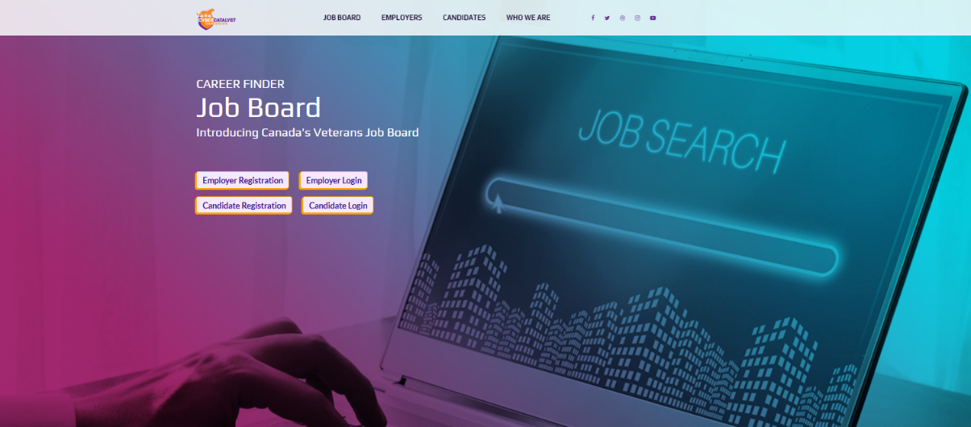
Unique Assistance for Candidates
Alliances supporting career interest definition, remote learning opportunities, certifications, remote work
Partnership with Veteran-led Mental Health team, security clearance sponsorship, and more…
Military Service ^{to} Cyber Defence

Slide 15






CyberCatalyst
Military Service ^{to} Cyber Defence
Notes:
We are a pan-Canadian not for profit providing asynchronous online micro credentialed technical skills and soft skills capabilities development, meshed with industry placements for experiential learning in Software and Cybersecurity careers. Through a unique strategic alliance, we provide mental wellness support and career coaching for candidates. But we don't stop at just preparing our candidates - we also facilitate dialogue between employers and candidates, ensuring a seamless transition into the workforce.
Employers are engaged within the Cyber Catalyst framework where a range of understanding and interaction is supported. We provide a unique candidate skills guarantee to employers – a low risk guarantee based on the level of interaction a candidate can have with a potential employer before a final interview is scheduled. We champion the continuum of Coach, Mentor and workplace Sponsor to support career resilience.
From a 2019 start we have achieved a community of nearly 400 candidates either registered or graduated from the veterans and underemployed civilian communities transitioning to new IT careers. Our unique approach combines educational partnerships with leading institutions such as the British Columbia Institute of Technology, University of Ottawa Professional Development Institute and George Brown College and includes instructors from those and several other post secondary schools as well as key industry-certified professionals. Industry partners in learning include Cisco NetAcad, Fortinet Academy, Cloud Range, Hacker Rank, O’Reilly Media and many others with job coaching and interview preparation, ensuring our candidates are well-equipped for success.

Slide 16

REACH OUT ANY TIME!
talent@cybercatalyst.io 1.877.629.1696 https://cybercatalyst.io/TechVets

